Slide 1
Lower bounds for Online Labeling/file maintenance.
Michael Saks
Rutgers University
Based on various papers joint with
Martin Babka, Jan Bulánek, Vladimír Čunát, Michal Koucký

Slide 2
Online Labeling
n items in U={1…r} arrive one by one
Items must be assigned a label in {1…m} with labels respecting underlying order
Relabel items as needed to preserve order
Each label or relabel has unit cost
(all other computation is free)

Slide 3
File Maintenance
Instead of labeling the n items from {1…m} store them in an array of length m.
Maintain items in sorted order
May leave gaps between stored items
Move items as needed to make room for arriving items
Each move has unit cost
(other computation is free)
Number of items n ≤ Array size m

Slide 4
A new item arrives
25
3 |  |  |  |  |  |  |  |  | 35
21
23
29
+3
+2
+1
Cost:

Slide 5
Equivalent formulation: Online labeling
Assign each arriving item a label in [1,m]
instead of storing it in an array
Labeling must be order preserving
Convention in the literature:
File maintenance refers to case m=O(n)

Slide 6
Some Applications
Cache-oblivous B-trees [Bender, Demaine, Farach-Colton ’00]
Cache-oblivous B-trees [Bender, Duan,Iacoco, Wu ’04]
Distributed Controllers[Emek, Korman ’11]
(For lower bounds)

Slide 7
Some history
Problem introduced by [Itai-Konheim-Rodeh ’81]:
Algorithm: Inserts n items in array of size m=Cn with cost O(nlog² n)
(Amortized O(log² n) per item)
Worst case O(log² n) per item [Willard ’92]
Simpler algorithms
[Bender-Cole-Demaine-FarachColton-Zito 02] [Itai, Katriel ’07]:

Slide 8
Some history II
Related abstract data type:
Order maintenance
[Sleator-Dietz 1988] O(1) per operation
[Bender-Cole-Demaine-FarachColton-Zito 02] Simplified algorithms

Slide 9
More history
For m = n^{1+c} IKR algorithm can be modified to O(log(n)) cost per item.
For m=n, [Zhang 93][Bird-Sadnicki 07]
O(log³(n)) cost per item

Slide 10
Upper bounds: Summary
Array Size | Cost / insertion
n(1+c) | O(log²(n))
n^{1+c} | O(log(n))
n | O(log³(n))
Main focus of this talk:
These are all best possible(!)
But first, a sketch of the upper bounds….

Slide 11
Sketch of Algorithm
When new item arrives….
….assign it (temporarily) to location with closest existing item
(Carefully) choose a segment containing new item…
……and rebalance the segment
12
21
25
28
40
24

Slide 12
Which segment to rebalance?
Assume m = 2^{k} = 2n
Construct binary tree of array segments
Leaves are individual cells
Root is entire array

Slide 13
Sketch of algorithm (m=2n=2^{k})
T₀=1/2+0/8=1/2
T₁=1/2+1/8=5/8
T₃=1/2+2/8=6/8
T₃=1/2+3/8=7/8
T₄=1/2+4/8=1
Density threshold Tj = 1/2 + (j/2k)

Slide 14
Sketch of algorithm (m=2n=2^{k})
3/8
T₀=1/2+0/8=1/2
7/16
1/2
1/2
1/2
1/2
1/2
1/2
T₁=1/2+1/8=5/8
1/2
3/8
3/8
1/2
1/2
1/4
1/2
1/2
T₃=1/2+2/8=6/8
3/4
1/4
1/2
0
1/2
1/2
1/2
0
1/2
T₃=1/2+3/8=7/8
1/2
1
8
11
15
19
24
29
T₄=1/2+4/8=1
14

Slide 15
Sketch of algorithm (m=2n=2^{k})
3/8
T₀=1/2+0/8=1/2
7/16
1/2
T₁=1/2+1/8=5/8
3/8
3/8
1/4
1/2
1/2
T₃=1/2+2/8=6/8
3/4
1/4
1/2
0
1/2
1/2
1/2
0
1/2
T₃=1/2+3/8=7/8
1/2
1
8
11
15
19
24
29
T₄=1/2+4/8=1
Find the highest node that is ≥ threshold
Recompute densities
Choose the segment defined by its parent
Rebalance!
14

Slide 16
Sketch of algorithm (m=2n=2^{k})
7/16
T₀=1/2+0/8=1/2
1/2
3/8
T₁=1/2+1/8=5/8
1/2
1/2
1/2
1/4
T₃=1/2+2/8=6/8
1/2
1/2
1/2
1/2
1/2
1/2
0
1/2
T₃=1/2+3/8=7/8
8
11
14
15
19
24
29
T₄=1/2+4/8=1

Slide 17
Which segment to rebalance?
Assume m = 2^{k} = 2n
Construct binary tree of array segments
Leaves are individual cells
Root is entire array
Each level has a density threshold
With each new item: After temporary placement, select largest segment S whose density threshold is exceeded… …..Rebalance the parent of S

Slide 18
Analysis of algorithm
Cost of rebalancing at level j: ≤ n/2^{j-1}
Claim: At most k2^{j} rebalancings at level j
→ Cost of rebalancings at level j ≤ 2kn
→ Cost of all rebalancings at level ≤ 2k²n
Proof of claim:When S at level j rebalances
Before firing: Density > ½ + j/2k
After firing: Density ≤ ½ +(j-1)/2k
→Between rebalancings of S:density goes up 1/2k
→ At least n/(k2^{j} ) items are inserted into S
→ At most k2^{j} rebalancings at level j

Slide 19
Upper bounds: Summary
Array Size | Cost / insertion
n(1+c) | O(log²(n))
n^{1+c} | O(log(n))
n | O(log³(n))
What about lower bounds….

Slide 20
Matching Lower bounds
Array Size | Cost / insertion | Matching LB
n(1+c) | O(log²(n)) | BKS (DZ 93)
n^{1+c} | O(log(n)) | DZS 94, 07 (BBCKS) BKS2(randomized)
n | O(log³(n)) | BKS
These are all best possible

Slide 21
Lower bounds: Poly(n) array size
m=n^{1+c}
Ω(log n) per insertion, amortized
[Dietz-Seiferas-Zhang ’94]
Simplify argument and extend to superpoly m
[Babka-Bulánek-Čunát -Koucký-S. 12]
Lower bounds extend to randomized algorithms
[Bulánek-Koucký-S. 13]

Slide 22
Lower bounds: Linear array size
[Dietz, Zhang ’93]
Ω(log² n) per insertion, amortized
Only applies to smooth algorithms
[Bulánek-Koucký-S ]
Extend LB to arbitrary (deterministic) algorithms
For the case m=n, matching lower bound of
Ω(log³ n) per insertion.

Slide 23
Remainder of talk….
Sketch of Ω (nlog²(n)) lower bound when m=O(n)
Proof builds on Dietz-Seiferas-Zhang lower bound for smooth algorithms

Slide 24
Game viewpoint
Adversary vs. Algorithm
At each step
Adversary introduces new item
Algorithm moves items and stores new item
Lower bound proof:
Describe and analyze adversary strategy

Slide 25
Game viewpoint II: Algorithm Strategy
At each step
Adversary introduces new item
Algorithm moves items and stores new item
Busy Region: Union of
location of new item
trajectories of all moved items
Cost of step = number of items in busy region
WLOG: Busy region is a single segment

Slide 26
Set up
2n items (instead of n)
Define δ = n/m (density parameter)
Initationalization:
Adversary picks set Y⁰ of n items
Algorithm stores them offline for free
Focus on final n steps of game
After t steps:
Item set Y^{t} of size n+t
Storage function F^{t}

Slide 27
Adversary strategy: Gaps
Current set Y of items
3 6 12 18 21 50
Gaps in Y:
(3,6) (6,12) (12,18) (18,21) (21,50)
At step t
adversary selects a gap (y,z) in Y
loads a new item in (y,z).
Which gap should he select?

Slide 28
Which gap to select?
Intuition: Select gap from crowded region of the array
Natural measure of crowding of segment S density(S) = Number of items in S
|S|
Difficulty: For gap G, the density of segments containing G may vary widely.
Want gap in crowded segments at all scales

Slide 29
A “universally dense” gap
Lemma. There is a gap G such that:
every segment containing it has density at least ½ the global density
(Easy but important observation [Dietz-Zhang]
--useful in many contexts]
Sufficient to prove Ω (nlog(n)) lower bound
but not Ω (nlog²(n))

Slide 30
Segment Chain Strategy
Adversary maintains a segment chain
[1,m] = S₀ ⊃ . . . ⊃ S_{d}
Next gap chosen inside S_{d}
Algorithm moves (determining busy segment)
Critical segment = smallest S_{j} containing busy segment
Adversary rebuilds chain below critical segment
Critical segment and segments above are unchanged.
Need to specify the rebuilding rule

Slide 31
Rebuilding rule: first attempt
Can choose a segment chain
S₀ ⊃ . . . ⊃ S_{d}
S₀ = [1,m]
Segments shrink by between ¼ and ½
Densities increase along the chain
Is a gap inside of S_{d} a good choice?

Slide 32
Foiling this rebuilding rule
S₀
S₁
S₂
S₃
S₄
Insertion into S₄:
Algorithm can move left—
escaping the crowded region!

Slide 33
Second attempt: Maintain well-buffered segments
For segment S:
Subsegment M partitions S into
L M R
M is well-buffered :
L and M each have at least ¼ of items in S

Slide 34
Rebuilding rule: 2nd Attempt
Maintain a segment chain
S₀ ⊃ . . . ⊃ S_{d}
d is Ω (log(n))
Densities increase along the chain
don’t decrease much
S_{i} is a well-buffered subsegment of S_{i-1}
-------------------

Slide 35
Well-buffered segment chains
Nested chain of segments
S₁ ⊃ . . . ⊃ S_{d}
is well-buffered if:
each segment is a well-buffered subsegment of its predecessor
Idea: Find a well-buffered chain
Length d is Ω(log(n))
Density does not decrease much
Choose gap inside S_{d}

Slide 36
Well-buffered segments chains
[DSZ 05] : Can maintain a well-buffered segment chain of length Ω (log(n)) with at most constant factor density decrease per segment
….decrease too fast for desired bound
….Need total decrease to be constant
[BKS 12] : Can maintain a well-buffered segment chain of length Ω (log(n)) with
density factor decrease 1- O(1/log n) per segment

Slide 37
Proving Ω (nlog²(n)) lower bound
[BKS 12] : Can maintain a well-buffered segment chain of length Ω (log(n)) with
density factor decrease 1- O(1/log n) per segment
Need:
How do we maintain this segment chain?
Why is this enough for the lower bound?

Slide 38
Rebuilding rule
[BKS 12] : Can maintain a well-buffered segment chain of length Ω (log(n)) with
density factor decrease 1- O(1/log n) per segment
In round t having chosen S₀ ⊃ . . . ⊃ S_{j}
choose S_{j+1}
Densest subinterval of size between ¼ and ½ of |S_{j} |?
Middle 1/3 of S_{j} ?
Key observation:
If Middle 1/3 fails, then S_{j+1} has a large subinterval with significantly larger density than S_{j+1}

Slide 39
Deducing the lower bound
[BKS 12] : Can maintain a well-buffered segment chain of length Ω (log(n)) with
density factor decrease 1- O(1/log n) per segment
During the game, adversary adds and removes segments from segment chain.
Lifespan L(S) of S
Removal of segment S implies algorithm paid O(|S|)
Amortized cost of S is A(S)= O(|S|)/L(S)
Total cost due to level j segments ≥ n min A(S)
Total cost is at least ≥ nlog(n) min A(S)
min A(S) = Ω (l) gives cost Ω (nlog(n))
A(S) is “typically” Ω (log(n)) gives cost Ω (nlog²(n))

Slide 40
Concluding remarks…
Results of BKS and BBCKS combine to give nearly tight lower bounds for all ranges of m from n to 2^{n}
Restricting range of input values:
Suppose inserted items are restricted to {1,…,r}.
If r≤m, then cost is just n.
How large must r be to get non-trivial lower bounds?
Ω (nlog²(n)) lower bound for linear array size holds even when r=Cm for some sufficiently large C

Slide 41
For array size m=n^{1+c}, the current proof of the Ω(nlog(n)) lower bound requires i r to be exponential in n?
Can one prove the same lower bound for significantly smaller r?
Might there me a o(n log(n)) or even O(n) cost algorithm if
r =Cm or even r=poly(m)?

Slide 42
Randomized algorithms
Ω (nlog(n)) lower bound for polynomial array size holds even for expected cost against randomized algorithms [BKS13]
For linear array size:
Does the Ω(n log²(n)) lower bound hold for randomized algorithms or…
….Is there a randomized algorithm of expected cost o(n log²(n)) or even O(nlog(n))?

Slide 43
Range of values
Upper bounds hold if items come from any totally ordered set
Suppose items are restricted to [1,r]
If r ≤ m, can insert at cost 1 per item
When m = Cn,
our lower bound holds provided r > C’n

Slide 44
Segment chain requirements
At each step t,
find well-buffered chain of length Ω(log(n))
very slow decrease in density--at most
1-O(1/log(n))

Slide 45
Algorithm for linear arrays – cont.
How to find segment to rearrange
Too dense
Rearrange items evenly
Good density

Slide 46
Sorted Arrays
Basis of many algorithms
Easy to work with
Dynamization?
Online Labeling

Slide 47
File Maintenance
Gaps in the array
Muze pohnout co chce
3 |  |  |  |  |  |  |  | 19
7
12
11
15
Array of size Θ(n)

Slide 48
Storing elements in the array
11
19
3
15
7
12
Gaps in the array
Muze pohnout co chce
Stream of n elements
3 |  |  |  |  |  |  |  | 19
7
12
11
15
Array of size Θ(n)

Slide 49
Upper bounds
[Itai, Konheim, Rodeh ’81]
O(log² n) per insertion, amortized
[Itai, Katriel ’07]
Simpler algorithm
Basic ideas
Small gaps
Spread items evenly
Density threshold function

Slide 50
Online labeling
Input:
A stream of n numbers
An array of size m
For the size Θ(n) File maintenance problem
Want:
maintain a sorted array of all already seen items
minimize the total number of item moves (cost)
Rict ze diry mi sami o sobe nestaci
Naïve solution O(n) per insertion

Slide 51
Super-polynomial array algorithm
[B., Koucký, Saks ’12]
O($\frac{\log{n}}{\log{\log{m}}}$ ) per insertion, amortized
Basic idea
Insertion to exponential size array is easy
Iteration of this approach

Slide 52
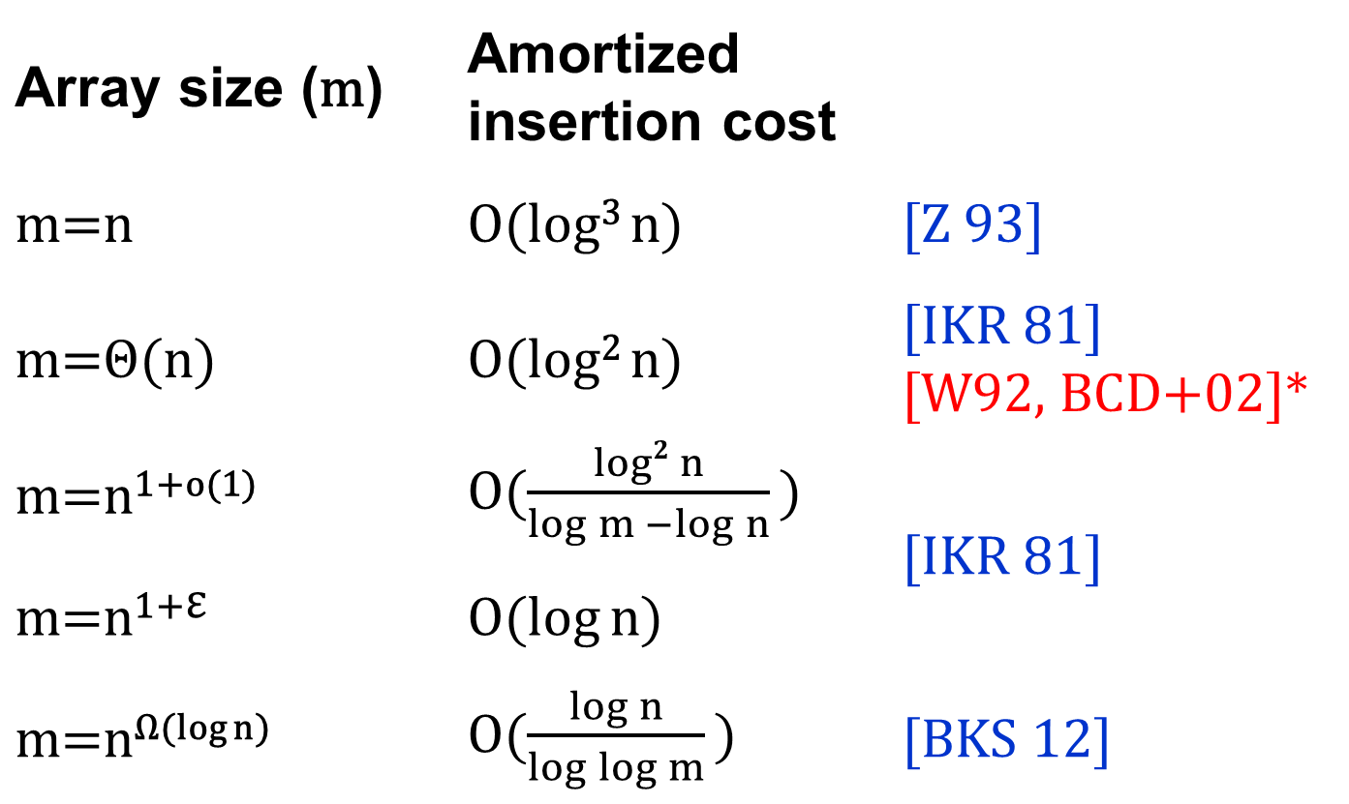
Upper bounds
Array size (m) | Amortized insertion cost
m=n | O(log³ n) | [Z 93]
m=Θ(n) | O(log² n) | [IKR 81] [W92, BCD+02]*
m=n^{1+o(1)} | O($\frac{log2{n}}{\log{m −\log{n}}}$ ) | [IKR 81]
m=n^{1+ℇ} | O(log n)
m=n^{Ω(log n)} | O($\frac{\log{n}}{\log{\log{m}}}$ ) | [BKS 12]
TIGHT!!
Andersson lai

Slide 53
Lower Bounds – cont.
[B., Koucký, Saks STOC’12]
All strategies
Uses some ideas from [Zhang 93]
Ω(log² n) per insertion, amortized
m=n | Ω(log³ n)
m=Θ(n) | Ω(log² n)

Slide 54
Lower Bounds – proof technique
Adversary
Generates input stream
Reacts on the state of the array
Inserts to dense areas

Slide 55
Lower Bounds – cont.
[Babka, B., Čunát, Koucký, Saks ESA’12]
All strategies
Fills the gap in [DSZ ’04] and extends their result
Tight bounds for the bucketing game
m=n^{1+Θ(1)} | Ω($\log{n}$)
m=n^{1+Ω (1)} | Ω($\frac{\log{n}}{\log{\log{m}−log log n}}$ )

Slide 56
Lower Bounds – cont.
[Babka, B., Čunát, Koucký, Saks 12, manuscript]
All strategies
Extends results of [BKS 12]
m=n^{1+o(1)} | Ω($\frac{log2{n}}{\log{m −\log{n}}}$ )

Slide 57
Lower Bounds – Sumary
Array size (m) | Insertion cost
m=n+a(n) | Ω(log² n$log\frac{n}{a(n)}$ )
m=cn | Ω($\text{log}\text{2 }\text{n}$)
m=n∙f(n) f(n)∊o(n) | Ω($\frac{log2{n}}{\log{f(n)}}$ )
m=n^{e(n)} e(n)∊Ω(1) | Ω($\frac{\log{n}}{\log{e(n)}}$ )

Slide 58
Limited universe
Trivial for r<m
U
1 | 2 | 3 | 4 | … | r-1 | r
 |  |  |  | …
m

Slide 59
Limited universe – cont.
Maybe easier for r small
U
1 | 2 | 3 | 4 | … | r-1 | r
 |  | 3 | 4 | …

Slide 60
Limited universe – cont.

Slide 61
Open problems
Randomized algorithms?
Limited universe m log n
The End!

Slide 62
Distributed controllers
$1
$1
$1
$1
$1
$1
$1
$1
$1
$1
$1
$1
$1

Slide 63
1
-5
32
7
14
…
3 |  | 7 |  |  | 12 | 15 |  | 19

Slide 64
1
-5
32
7
…
3 | 7 |  |  | 12 | 14 |  | 15 | 19

Slide 65
1
-5
32
7
…
14
3 |  | 7 |  |  | 12 | 15 |  | 19

Slide 66
Algorithm for linear arrays – cont.
How to find segment to rearrange
Too dense
Rearrange items
Good density

Slide 67
Algorithm for linear arrays – cont.
How to find segment to rearrange
Too dense
Rearrange items
Good density

Slide 68
Algorithm for linear arrays – cont.
How to find segment to rearrange
Too dense
Good density

Slide 69
Algorithm for linear arrays – cont.
How to find segment to rearrange
Too dense

Slide 70
Algorithm for linear arrays – cont.
How to find segment to rearrange
Too dense
Good density

Slide 71
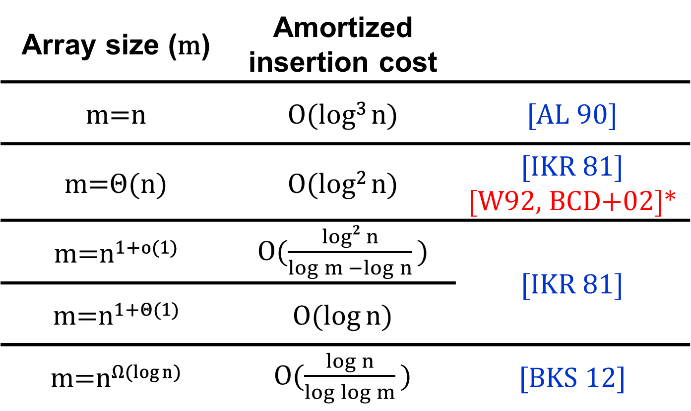
Upper bounds
Array size (m) | Amortized insertion cost
m=n | O(log³ n) | [AL 90]
m=Θ(n) | O(log² n) | [IKR 81] [W92, BCD+02]*
m=n^{1+o(1)} | O($\frac{log2{n}}{\log{m −\log{n}}}$ ) | [IKR 81]
m=n^{1+Θ(1)} | O(log n)
m=n^{Ω(log n)} | O($\frac{\log{n}}{\log{\log{m}}}$ ) | [BKS 12]
Andersson lai
TIGHT!!

